Slide 1
Microcontroller & Interfacing IoT Lab
IoT-4214
INSTRUCTED BY:
Samsuddin Ahmed,
Aassociate Professor
Suman Saha
Lecturer,
Dept. of ICT,BDU
PRESENTED BY:
Md. Muntasire Mahamud
ID: 1901012
Md. Shakil Mia
ID: 1901023
Session: 2019-2020
2nd year 2nd semester.
Program: IoT
Presentation on:
Short Range Radar System

Slide 2
ABSTRACT -
Radar is an object detection system that uses electromagnetic waves to identify range, altitude, direction, or speed of both moving and fixed objects such as aircraft, ships, vehicles , weather formations, and terrain. When we use ultrasonic waves instead of electromagnetic waves, we call it ultrasonic radar.
The main components in any ultrasonic radar are the ultrasonic Sensors.
Ultrasonic sensors work on a principle similar to radar or sonar which evaluates attributes of a target by interpreting the echoes from radio or sound waves respectively.
Radar’s information will appear in different ways. Basic and old radar station used sound alarm or LED, modern radar uses LCD display to show detailed information of the targeted object. We use Computer screen to show the information (distance and angle).

Slide 3
Objectives
Uses radio waves to determine the distance.
BRANCH
Angle, and radial velocity of objects relative to the site.
It operates by transmitting electromagnetic energy toward objects.
Can be used to detect aircraft, ships, spacecraft, motor vehicles.
BRANCH STAFF

Slide 4
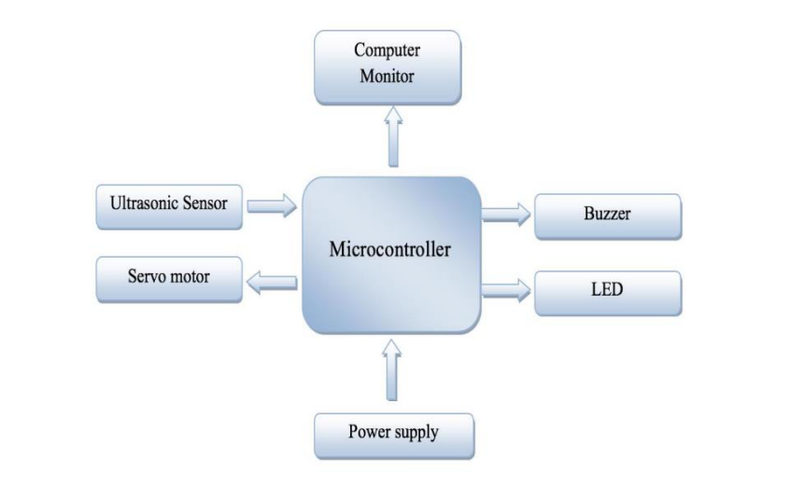
Novelty & Advantages-
Low
Cost
Delivered
low maintenance
Focusing light
Destination
Sound Alarming

Slide 5
Conclusion
We have represented a project on Ultrasonic RADAR for security system for human or object interference in a shortrange.
The system has been successfully implemented and the aim is achieved without any deviation. There is a lot of future scope of this project because of its security capacity.
It can be used in many applications. This project can also be developed or modified according to the rising needs and demand.

Slide 6
References
[1] https://www.irjet.net/archives/V4/i10/IRJET-V4I1059.pdf [2] https://create.arduino.cc/projecthub/rexhepmustafovski/arduino-radar- with-simulink [3] https://create.arduino.cc/projecthub/faweiz/arduino-radar [4] http://radartutorial.en (intro, principle of operation) [5] http://microcontrollerslab.com/servo-motor-control and-interfacing- with-arduino [6] https://en.wikipedia.org [7] http://robotforpro.blogspot.in (sensor)
[8] J.G .Proakis, “Digital Comm.”, fourth edition. NY: McGraw- Hill, 2001 [9] R.BaraniukandP.Steeghs, [10] “Compressive radio detection and ranging imaging” in IEEE [11] Wikipedia

